Slide 1
V6 Installation Overview
How to Install ENOVIA V6 Servers and Clients
Notes:
This is the “Presentation title” page. Type the title of your presentation in the "Presentation title” field.
Cette page est la page de titred’uneprésentation . Saisissezvotretitredans la zone « Titre de la présentation ».

Slide 2
Learning Objectives
At the end of this module, you should be able to:
Describe overall installation strategy for ENOVIA servers including prerequisites
Describe installation of an MCS, FCS, Advanced Search and 3D Index Server
Describe the installation and configuration of a Conferencing server for Global Collaboration

Slide 3
Agenda
1
Installation Overview
2
DB installation and Setup
3
ENOVIA Application Server Installation
4
FCS installation and Setup
5
Conferencing Server Installation
6
3D Index Search Server Installation
7
Advanced Search Server Installation
8
Client Installation
Notes:
Change the order of DB and ENOVIAAppServer in all Agenda slide
Add LDAP Integration in ENOVIA AppServer

Slide 4
Agenda
1
Installation Overview
2
DB installation and Setup
3
ENOVIA Application Server Installation
4
FCS installation and Setup
5
Conferencing Server Installation
6
3D Index Search Server Installation
7
Advanced Search Server Installation
8
Client Installation

Slide 5
Using this presentation
This presentation is designed to help the ENOVIA V6 implementer plan the installation process
Depending on whether it is a demo or production installation, the steps can greatly vary
Here we will detail a demo installation and in the appendices we will detail the differences in a production installation
Other appendices will treat installing patches, deployment procedures, customization, adding clustered machines for example, remote installs, etc.

Slide 6
Before We Start
Prerequisites
License Management (license server and obtaining of licenses)
Middleware Components and Patches (Java, WebSphere, Tomcat, DB2, Oracle, Sametime, OCS2007, Autonomy IDOL, …)
ENOVIA Products and Configurations to be installed
Architecture Choice (Monolithic, 3-Tier, LDAP Integration, etc)
File Systems (mount points and free space)
User Accounts and Passwords (operating system level users, administration, application users)
Operating System Levels + Patches
Kernel Parameters / Registry Tuning

Slide 7
V6 Packaging Model – Overall View
SH
Shareable
NU
Named User
SH
NU
CATIA Product
DELMIA Product
NU
CATIA Product
DELMIA Product
NU
ENOVIA VPM Product
ENOVIA i-PLM Product
NU
NU
(VPM) ENOVIA VPM Central
3DLive Product
NU
NU
(LIV) ENOVIA 3DLive
(CPF) ENOVIA Live Collaboration
NU
Same common Prereq: “ENOVIA Live Collaboration” (CPF) for almost all Products.
Same common Prereq: “3DLive” (LIV) + “ENOVIA VPM Central” (VPM) for all authoring (Creators) products.
Named User licensing for most products

Slide 8
Before We Start License Management
License server and obtaining of licenses
For DB2, you must convert the temporary license shipped with the product to a permanent license DB2_Enterp_Svr_Auth_User_Activation.zip/db2ese_u.lic using db2licm –a (see page 67 of the IDSICC installation guide)
For ENOVIA V6, LUM V4 and LUM V5 licenses are required in nodelocked form
Install the license server DSLS (DS-provided OEM server for LUM V5) if you are importing concurrent licenses
Run i4target (LUM V4) and lumtarget (LUM V5) on your server(s)
Request licenses for all products to be installed
CPF – ENOVIA V6 Server (required) – LUM V4
PIX – 3D Index Server (optional) – LUM V5
DTE – If ONLY using Studio Modeling and nothing else – LUM V4
Notes:
Note that PIX will go away in v2010

Slide 9
Before We Start Middleware Components and Patches (V2009x)
Download the following versions of the required middleware
Software | Version | Patch Level | Website
IBM Stack
IBM JDK | 5 SR7 | N/A | Comes with WebSphere
WebSphereAppSvr Base + HTTP Server + WebServerPlugin | 6.1 | Fix Pack 17 | http://w3-103.ibm.com/software/xl/portal - Main Bundle (see notes) http://www-1.ibm.com/support/docview.wss?rs=180&uid=swg27009393 - Fix Pack
DB2 Universal DB | 9.1 | Fix Pack 05 | http://www-1.ibm.com/support/docview.wss?rs=71&uid=swg21254867 - Full Download
Sametime Server | 7.5.1 | Cumulative Fix 03 | http://w3-103.ibm.com/software/xl/portal - Main Bundle (see notes)
Domino Server | 7.0.3 | N/A | http://w3-103.ibm.com/software/xl/portal - Main Bundle (see notes)
For AIX: GNUtar | 1.14 | N/A | http://ftp.cc.uoc.gr/AIX/freeware/4.3.3
Non-IBMStack
Java6 SDK | 6.0 | SDK 6 Update 4 or higher | http://java.sun.com/javase/downloads/?intcmp=1281
Apache (optional) | 2.2.0 |  | http://www.apache.org
Tomcat | 6.0.16 | N/A | http://archive.apache.org/dist/tomcat/tomcat-6/v6.0.16/bin/
Oracle | 10.2 | 10.2.0.3 | http://technet.oracle.com -Base 10.2.0.1 image http://metalink.oracle.com -Patchset for 10.2.0.3
Active Directory (for OCS) | ? |  | http://www.microsoft.com
Office Communication Server | 2007 | N/A | http://www.microsoft.com
Notes:
WebSphere
For AIX:
C87QUML – WAS V6.1
C87PPMLL – WAS V6.1 Supplements
For Windows:
Xxx
Xxx
For RHEL5:
C88STML – WAS ND 6.1
C88UQML – Edge Components WAS 6.1
C19PRML –WebServices
C88T0ML – WAS ND 6.1 Supplements
Sametime/Domino
For AIX:
C164DEN – Domino Server
C1079ML –Sametime server
C13DHML – CF Pack 1
C88RDNA – Administration
C86U9NA - Toolkit
For Windows:
Cxxxxx
Cxxxxx
C88RDNA – Administration
C86U9NA – Toolkit
For RHEL5:
C1079ML –Sametime 7.5.1
C13DHML –Sametime 7.5.1 CD1
C14F8ML –Sametime 8
C164FEN – Domino 7.0.3
C1AU4EN – Domino 7.0.3 FP1
C18XSEN – Domino 8

Slide 10
Before We Start ENOVIA V6 Products and Options
Minimal Configuration:
ENOVIA Studio Modeling Platform
ENOVIA Live Collaboration Server
ENOVIA Live Collaboration Business Process Services
CATIA V6 / DELMIA V6 / SIMULIA V6 / 3DVIA V6 Integration
ENOVIA Live Collaboration Platform Server VPM
Other Centrals for xBOM / Governance Modules
For example: Engineering Central, Variant Configuration, Requirements Management
Other Options
3D Index Server
Advanced Search (included with ENOVIA Live Collaboration Server)
xPDM Orchestration Server
Batch Server
Crystal Reports and many more possibilities
NOTE: Be sure not to forget to check the Program Directory CD for late-breaking release notes!

Slide 11
Before We Start Architecture Choice
In a demo environment, most likely all components will be installed on the same system which will serve as the ENOVIA Application Server (MCS), the Database Server (DB) and the Advanced Search Server (NDX)
In a real, production-type environment, it is desirable to separate the various elements on different servers
Database Server – need to ensure that the connection string in MATRIX-R bootstrap file is correct
FCS Server – actually a separate installation described later in this presentation, the FCS is a Live Collaboration Server with no database connection. It is also required to update the MCS with the System program to connect to the FCS.
3D Index Server – server is installed and then each of the Desktop (CATIA, DELMIA, SIMULIA, and 3DLive) clients must be configured to connect to this server
Advanced Search Server – requires the Studio Modeling Platform (at least MQL) and Live Collaboration Platform. This implies that this server will also required a CPF license.
Conferencing Server – install Lotus Sametime and Lotus Domino (or Microsoft Office Collaboration Server 2007). It requires detailed configuration in (refer to the IDSICC installation guide)
Notes:
3D Index Server run in HTTPS over port 443
How/if configure 3DVIA for 3D Index Search??

Slide 12
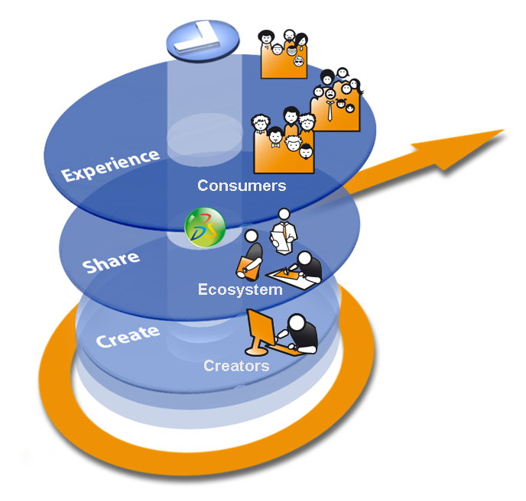
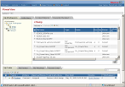
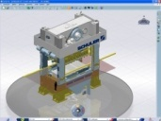






V6 Multi-Tier Architecture Principle
Web Clients Ex.: ENOVIA xBOM / Governance
Presentation
Light Visualization Clients Ex.: ENOVIA 3DLive
Workstation Clients Ex.: CATIA V6, DELMIA V6, SIMULIA V6, xCAD…
Clients
HTTP
A
Logic
Applications Server(s) (MCS)
Index Servers * Indexing Repository
S
F
File Server(s) (FCS) Representation and Content Repository
Data
D
(*) Optional.
Database Server: Metadata Repository
Notes:
Data Tier
- Database Server Role: Storage of meta data i.e. “data about data”.
- Search Server
Role: Index meta data and files for key word searching and refinement.
- File Server called in ENOVIA “File Collaboration Server” or FCS / STORE
Role: Rapid storage and retrieval of representations (like CAD geometry for instance).
Physical view: Application Server + File server w/ FCS applications installed – the application server being limited to transfer files for the file server to the client seat.
Logic Tier
- Application Server called in ENOVIA “Main Collaboration Server” or (MCS) / RDBMS
Role: Handle the business logic and data access of the applications.
Physical view: Application Server w/ MCS applications installed
- Web Server(s) Role: Accept HTTP requests from web clients and serve them HTTP responses along with optional static contents (web pages, style sheets, java scripts, etc.).
Can be also used as a proxy/load balancing server.

Slide 13





ENOVIA V6
Deployment Examples
Demo
Sandbox /
Training
Proof of Concept
Production Prototype
MCS + FCS +DB+NDX
MCS + FCS +DB Client +NDX
MCS +DB Client
FCS Server
Advanced Search Server
MCS +DB Client
FCS Server
DB Server
DB Server
3D Index Server
DB Server
Conferencing Server
Notes:
13
Different Technical infrastructure configurations to be defined according to customers requirements.
Examples of criteria:
number of users,
scalability requirements,
performance requirements
System management requirements
project phase,
geographical constraints,
E.g: The minimal installation could be used as a development platform as well as for functional tests and education.
Typically at deployment each Server is associated to a separate physical machine or partition.
Also shown in this architecture is the ability to use multiple application servers for scalability. Each application server is configured to run in a “RMI-in-process”, or RIP, mode. This consolidates the application server and the ENOVIA kernel into the same JVM for the utmost performance. The web server could be used as a proxy/load-balancing server and also increases performance by delivering static web content. A hardware load-balancer could also be deployed. The number of application servers depends on the number of concurrent users and the capacity of the application server in terms of the number of CPUs and the maximum amount of RAM. This could also be a single physical machine running multiple server processes.

Slide 14
Before We Start AIX File Systems – mount points and req’d space
Software | Location | Space required | User
IBM Stack
WebSphereAppSvr (incl. Java and HTTP Server) | /appsrv/ibm/ | 2 GB | wasadm (Appsvr) root (HTTP)
DB2 Universal DB Binaries | /opt/IBM/db2/V9.1 | 2 GB | db2adm9
Domino Server Binaries | /opt/ibm/lotus | 1 GB | domino
Sametime Data | /stsrv/local/notesdata | 1 GB | domino
Non-IBMStack
Java5 SDK | /opt/java | 200 MB | root
Tomcat | /opt/tomcat | 500 MB | root
Oracle | /opt/oracle/ | 2 GB | ora10g
Common Stack
ENOVIA V6 Modeling Studio +ENOVIA V6 RMI Server | /enovia (with studio and rmi subdirectories) | 2 GB | Install as root write access to AppSrv Owner
Database files | /dbdata/ | At least 5 GB | ora10g or db2adm9
File Store | /store | At least 1 GB | AppSrv Owner ftpuser (MCS/FCS transfers)

Slide 15
Before We Start Windows File Systems – directories and req’d space
Software | Location | Space required | User
IBM Stack
IBM JDK | C:\jdk1.5.0 | 50 MB | Administrator
WebSphereAppSvr | C:\appsrv | 300 MB | wasadm (Appsvr), Administrator(HTTP)
DB2 Universal DB | C:\db2 | 2 GB | db2adm9, db2user
Sametime Server | C:\sametime | 1 GB | domino
Domino Server | C:\domino | 2 GB | domino
Non-IBMStack
Java5 SDK | C:\jdk1.5.0 | 50 MB | Administrator
Tomcat | C:\tools\tomcat | 100 MB | Administrator
Oracle | C:\oracle\ora10g | 2 GB | ora10g
Office Communication Server 2007 | C:\program files\ocs2007 + c:\lc data | 2 GB | Domain admin (see install docs)
ENOVIA V6 Modeling Studio | C:\enovia\studio | 2 GB | ev6adm
ENOVIA V6 RMI Server | C:\enovia\rmi | 1 GB | ev6adm
Database files | C:\data | At least 5 GB | ora10g or db2adm9
File Store | C:\store | At least 1 GB | enovadm6

Slide 16
Before We Start Operating System Notes
Operating System Levels
Windows 2003 Server Enterprise Edition with SP2 (should be R2) 32- and 64-bit
AIX 5.3L TL05-03+ for POWER5 or POWER6
Filesets required: xlC.aix50.rte (Version 8.0.0.0)
GNUtar version 1.14
NOTE: Strongly recommended to use JFS2 for all file systems
RHEL 5 64-bit Update 1
NOTE: Strongly recommended to ext3 for all file systems
Non-VPM environments
Solaris10 x86 or SPARC with xxx patches
Swap
2x main memory for maximum safety
Base Tuning
Kernel parameters from xxx document
Registry tuning for Windows from xxx document

Slide 17
Agenda
1
Installation Overview
2
DB installation and Setup
3
ENOVIA Application Server Installation
4
FCS installation and Setup
5
Conferencing Server Installation
6
3D Index Search Server Installation
7
Advanced Search Server Installation
8
Client Installation

Slide 18
Database Installation
Ensure correct kernel parameters, operating system patches
Install Database Code and Appropriate Patches
Prepare logical volumes or LUNs for datafile placement
Create Database using provided script (CRTENOVIA.ksh for DB2)
Later for ENOVIA Schema creation:
Install Studio Modeling component
Create bootstrap (MATRIX-R) file using System application
Continue install
NOTE: If problems occur during VPM Central install, you must recreate the database or restore from a backup created before VPM Central Install

Slide 19
Disk Storage Best Practices
Disk Layout
If on a non-RAID environment, try to keep separate disks (as possible) for
Indexes Tablespace
User Data/Blobs Tablespaces
Redo logs
System/Temp/Undo (rollback) Tablespaces
This will improve overall throughput
If on a large Storage Array, see the next slide
Notes:
19

Slide 20
Typical Disk Layout with Striping
RAID 1 or JBOD
LogFile1
LogFile2
Archive Logs
Data, Index, Undo, Temp
Data, Index, Undo, Temp
One Large Set of Disks
for Oracle Datafiles
Data, Index, Undo, Temp
File Store/Vault, IDOL and 3D Indexes
One Large Set of Disks
for Non-Sequential Data
File Store/Vault, IDOL and 3D Indexes
Notes:
20

Slide 21
Note about installation DB2 (Code Installation)
There are two methods to install DB2:
Installation of the product either with noFixPackand then install theFixPacklater or
Installation of the full product including theFixPackdirectly.
The method shown here is the 2nd on with the included FixPack
Install the full product DB2 V9.1 FixPack 4 (as recommended by Progam Directory) – Note the download location is listed in the slides in the first chapter of this presentation
Best Practice: install the db2sampl database for validation that everything is work
Create a user (the following example uses plmadmin) at the operating system level and make it a member of the db2admin group
V9.1
+
FP4

Slide 22
Note about installation DB2 (Create Database)
Example Database Creation Script
Be careful, this script is relevant for a specific hardware machine, please adapt it for your environment – substitute your database file path for <MY-CONTAINERS-PATH> and your database name for <MY-V6-DATABASE>
NOTE: The <MY-CONTAINERS-PATH> must exist before running this script
NOTE: System Memory dedicated to the database is the buffer pool size so 30000 pages @ 8k per page ≅ 230 MB for BP1 below
NOTE: Disk Space follows the same rule: those shown here are ≅ 500MB each
db2 "CREATE DATABASE MY-V6-DATABASE ON 'MY-CONTAINERS-PATH' USING CODESET UTF-8 TERRITORY US COLLATE USING IDENTITY PAGESIZE 8192" db2 "CONNECT to MY-V6-DATABASE" db2 "CREATE BUFFERPOOL BP1 SIZE 30000 PAGESIZE 8192 NOT EXTENDED STORAGE" db2 "DISCONNECT current" db2 "CONNECT TO MY-V6-DATABASE" db2 "create user temporarytablespace TEMPSPACE2 pagesize 8192 MANAGED BY DATABASE using ( FILE 'MY-CONTAINERS-PATH/TEMPSPACE2' 64000) bufferpool IBMDEFAULTBP" db2 "CREATE LARGE TABLESPACE TBS_REG PAGESIZE 8192 MANAGED BY DATABASE USING (FILE 'MY-CONTAINERS-PATH/TBS_REG' 64000) BUFFERPOOL BP1 EXTENTSIZE 32 PREFETCHSIZE 32 FILE SYSTEM CACHING DROPPED TABLE RECOVERY ON" db2 "CREATE LARGE TABLESPACE TBS_IDX PAGESIZE 8192 MANAGED BY DATABASE USING (FILE 'MY-CONTAINERS-PATH/TBS_IDX' 64000) BUFFERPOOL BP1 EXTENTSIZE 32 PREFETCHSIZE 32 FILE SYSTEM CACHING DROPPED TABLE RECOVERY ON "

Slide 23
Note about installation DB2 (Create Database)
DB2 Updating database (1)
db2 "update dbcfg for MY-V6-DATABASE using SHEAPTHRES_SHR AUTOMATIC" db2 "update dbcfg for MY-V6-DATABASE using SORTHEAP 8000" db2 "update dbcfg for MY-V6-DATABASE using NUM_IOCLEANERS 20" db2 "update dbcfg for MY-V6-DATABASE using NUM_IOSERVERS 10" db2 "update dbcfg for MY-V6-DATABASE using MAXAPPLS 200" db2 "update dbcfg for MY-V6-DATABASE using BUFFPAGE 50000" db2 "update dbcfg for MY-V6-DATABASE using LOGFILSIZ 16000" db2 "update dbcfg for MY-V6-DATABASE using APPLHEAPSZ 8192" db2 "update dbcfg for MY-V6-DATABASE using APP_CTL_HEAP_SZ 8192" db2 "update dbcfg for MY-V6-DATABASE using STMTHEAP 12000" db2 "update dbcfg for MY-V6-DATABASE using DBHEAP 20000" db2 "update dbcfg for MY-V6-DATABASE using CATALOGCACHE_SZ 6000" db2 "update dbcfg for MY-V6-DATABASE using LOCKLIST 10000" db2 "update dbcfg for MY-V6-DATABASE using LOGBUFSZ 2048" db2 "update dbcfg for MY-V6-DATABASE using UTIL_HEAP_SZ 10000" db2 "update dbcfg for MY-V6-DATABASE using MAXLOCKS 75"

Slide 24
Note about installation DB2 (Create Database)
DB2 Updating database (2)
db2 "update dbcfg for MY-V6-DATABASE using STAT_HEAP_SZ 5000" db2 "update dbcfg for MY-V6-DATABASE using LOGPRIMARY 12" db2 "update dbcfg for MY-V6-DATABASE using LOGSECOND 2" db2 "update dbcfg for MY-V6-DATABASE using AUTO_MAINT OFF" db2 "update dbcfg for MY-V6-DATABASE using AUTO_TBL_MAINT OFF" db2 "update dbcfg for MY-V6-DATABASE using AUTO_RUNSTATS ON" db2 "update dbcfg for MY-V6-DATABASE using PCKCACHESZ 8000" db2 "update dbcfg for MY-V6-DATABASE using LOGARCHMETH1 OFF" db2 "update dbcfg for MY-V6-DATABASE using LOGARCHMETH2 OFF" db2 "update dbcfg for MY-V6-DATABASE using SELF_TUNING_MEM ON" db2 "update dbcfg for MY-V6-DATABASE using SHEAPTHRES_SHR 12164" db2 "update dbcfg for MY-V6-DATABASE using APPGROUP_MEM_SZ 30000" db2 "update dbcfg for MY-V6-DATABASE using CHNGPGS_THRESH 80" db2 "update dbcfg for MY-V6-DATABASE using GROUPHEAP_RATIO 70" db2 "update dbcfg for MY-V6-DATABASE using DLCHKTIME 10000" db2 "update dbcfg for MY-V6-DATABASE using AVG_APPLS AUTOMATIC" db2 "update dbcfg for MY-V6-DATABASE using LOCKTIMEOUT 30" db2 "ALTER bufferpool IBMDEFAULTBP size 10000"

Slide 25
Note about installation DB2 (Create Database)
DB2 changing privilege database (3)
db2 "GRANT DBADM, CREATETAB, BINDADD, CONNECT, CREATE_NOT_FENCED_ROUTINE, IMPLICIT_SCHEMA,LOAD, CREATE_EXTERNAL_ROUTINE, QUIESCE_CONNECT ON DATABASE TO USER PLMADMIN" db2 "GRANT USE OF TABLESPACE TBS_REG TO USER PLMADMIN WITH GRANT OPTION" db2 "GRANT USE OF TABLESPACE TBS_IDX TO USER PLMADMIN WITH GRANT OPTION" db2 "GRANT USE OF TABLESPACE USERSPACE1 TO USER PLMADMIN WITH GRANT OPTION" db2 "GRANT USE OF TABLESPACE TEMPSPACE2 TO USER PLMADMIN WITH GRANT OPTION" db2 "DISCONNECT current" db2 terminate

Slide 26
Oracle Installation (1/
Download Oracle 10.2.0.1 for the target platform from technet.oracle.com (free registration to the site required – see http://w3.tap.ibm.com/w3ki2/pages/viewpage.action?pageId=223267)
Download the 10.2.0.3 patch from metalink.oracle.com (login and registration required – see intranet page http://w3.tap.ibm.com/w3ki2/display/GBSPAK/Oracle+Online+Resources+Available)
Verify the prereqs for Oracle installation by platformfromMetalink Article 169706.1 and the README that comes with the installation media downloaded above
Enterprise Edition is only required if your system will be > 4 CPU sockets – ENOVIA uses none of the Enterprise features so the choice should be made exclusively on # of CPU sockets on the server (see http://www.oracle.com/corporate/pricing/databaselicensing.pdf)

Slide 27
Oracle Installation (2/
Create an dba group and and oracle user as member of that group and launch the installer as that user
The defaults for Oracle Standard Edition can be chosen (ensure you select the Oracle Enterprise Manager to use the web-based admin tools)
Select Create a database
Most of the defaults can be used
Remove all the database options (XML, JVM, Example Schemas, etc.) as they are not required
Add the TBS_REG and TBS_IDX tables for ENOVIA data
See the Oracle Tuning class for more on tuning Oracle

Slide 28
Oracle Networking
Open the file <ORACLE_HOME>/network/admin/listener.ora and verifythatitcontains the following information:
LISTENER=
(DESCRIPTION_LIST =
(DESCRIPTION =
(ADDRESS_LIST =
(ADDRESS = (PROTOCOL = TCP)(HOST = <HOSTNAME>)(PORT = 1521))
)
)
)
SID_LIST_LISTENER =
(SID_LIST =
(SID_DESC =
(ORACLE_HOME = <ORACLE_HOME>)
(SID_NAME = <SID>)
)
)
Open the file <ORACLE_HOME>/network/admin/tnsnames.ora and verifyitcontains the following information:
<SID>=
(DESCRIPTION =
(ADDRESS_LIST =
(ADDRESS = (PROTOCOL = TCP)(HOST = <HOSTNAME>)(PORT = 1521))
)
(CONNECT_DATA =
(SID = <SID>)
)
)
Test the listener:
startup: lsnrctlstart
test: tnsping<SID>
Don’tforget to add ORACLE_HOME, ORACLE_SID, and ORACLE_BASE to the oracle .profile!

Slide 29
Agenda
1
Installation Overview
2
DB installation and Setup
3
ENOVIA Application Server Installation
4
FCS installation and Setup
5
Conferencing Server Installation
6
3D Index Search Server Installation
7
Advanced Search Server Installation
8
Client Installation

Slide 30
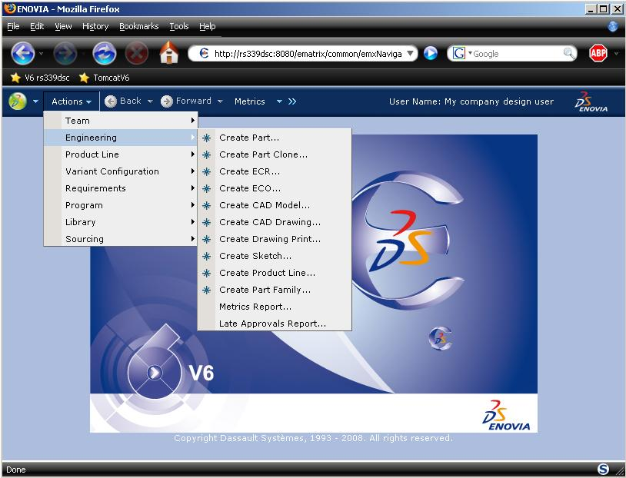
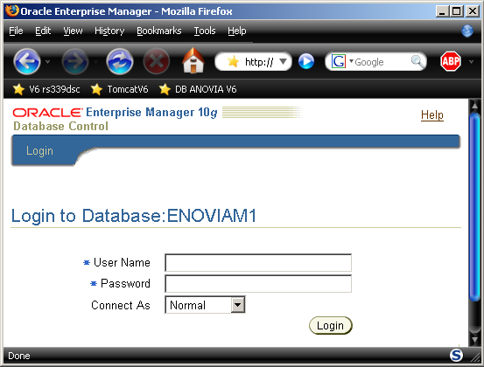
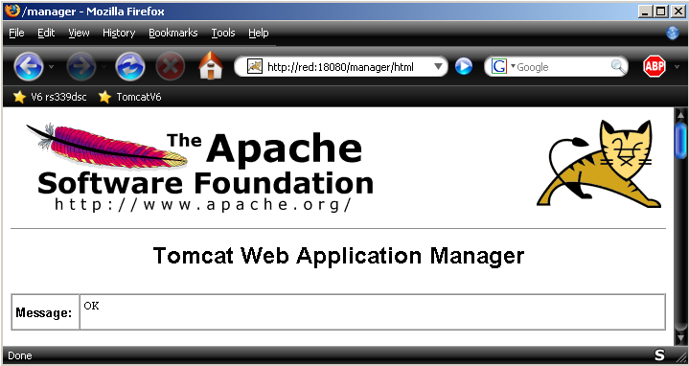



ENOVIA Application Server Installation
Prerequisites
Relational DB
Java
HTTP Server + Application Server
Browser
LUM4 and LUM5 licenses
ENOVIA V6 medias

Slide 31


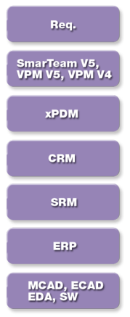
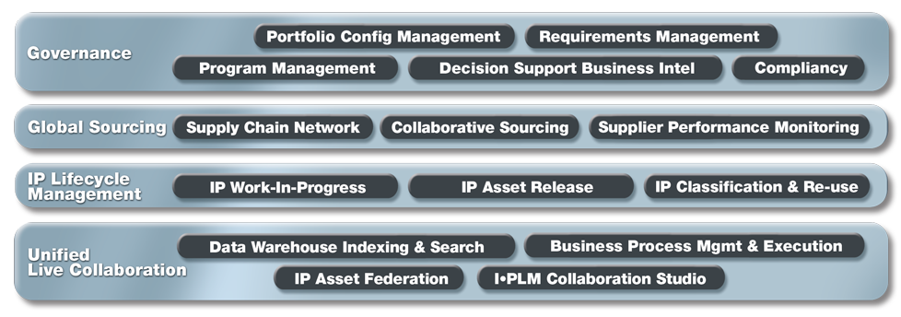


Two Platform Choices based on Modules…
VPM V6 Platform Support (Rich Client Support)
Collaborative Innovation
All Others: xBOM/Governance
The platform choice for VPM V6 is more restrictive than the xBOM/Governance modules. In the case of installing both xBOM/Governance and VPM V6 modules, you must of course choose from the more restrictive platform choices of VPM V6
Notes:
31
31
Let’s zoom into the V6 Solution Referential:
At the modeling & simulation level we have CATIA for Virtual Design, SIMULIA for Virtual Testing & Compliancy & DELMIA for Virtual Manufacturing & Production.
ENOVIA is the fundamental component for Global Collaborative Innovation for PLM.
Four main domains:
Live Collaboration Platform
IP Lifecycle Management
Global Sourcing
Governance
Deliver integration with large number of applications and enterprise application

Slide 32
Platforms OS Middleware – xBOM/Governance
Windows Server 2003 32-bit/64-bit
Linux RHEL 5 64bit
Servers
AIX 5.3 64-bit
Solaris 10 (SPARC or AMD) 64-bit
WebSphere6.1 32-bit IBM JVM
TOMCAT 6.0.16 32-bit Sun JVM
Weblogic10 32-bit
Application Servers
DB2 V9.1 (Windows Server/AIX)
Oracle 10.2.0.3 (All Platforms)
MySQL Enterprise (Linux)
MS SQLServer2005
RDBMS

Slide 33
Platforms OS Middleware
Servers
Windows Server 2003 32-bit/64-bit
Linux RHEL 5 64bit
AIX 5.3 64-bit
Solaris 10 (SPARC or AMD) 64-bit
App Servers
xBOM/Governance
WebSphere6.1 32-bit IBM JVM
TOMCAT 6.0.16 32-bit Sun JVM
Weblogic10 32-bit
DB2 V9.1 (Windows Server/AIX)
Oracle 10.2.0.3 (All Platforms)
MySQL Enterprise (Linux)
MS SQLServer2005
Servers
Windows Server 2003 32-bit/64-bit
Linux RHEL 5 64-bit
AIX 5.3 64-bit
VPM
WebSphere 6.1 32-bit IBM JVM
TOMCAT 6.0.16 32-bit Sun JVM
App Servers
DB2 V9.1 (Windows Server/AIX)
Oracle 10.2.0.3 (All Platforms)
MS SQLServer2005
RDBMS

Slide 34
Server Installation – Main Steps
Pre-requisite check
Relational Database Preparation
Creation oracle/db2 database
Application Server installation
Tomcat / WebSphere
Installation of ENOVIA code applications
ENOVIA Studio Modeling Platform
Bootstrap file creation
ENOVIA Live Collaboration Server
ENOVIA Live Collaboration Platform Business Process Services
… Install additional Applications
ENOVIA Live Collaboration Platform Server VPM
Compile the Java Program Objects (JPOs)
Build the ear/war file
Deploy ear/war on the Application Server

Slide 35

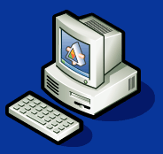
V6 Basic Installation - Presentation
Server Code
ENOVIA Studio Modeling Platform
ENOVIA Live Collaboration Server
ENOVIA Live Collaboration Business Process Services
ENOVIA Live Collaboration Platform Server VPM
Database Code
Web Application Package (ear/war)
Application Server Code
ENOVIA Live Collaboration Server
File Collaboration Server Code
CATIA V6
3Dlive
Delmia V6
Simulia V6
Client Code
ear/war
Application Server Code

Slide 36
V6 Installation & Deployment – Main Steps
Server Code
FCS
Client
Codes Installation :
Database
Centrals
Application server
Codes Installation :
ENOVIA Live Collaboration Server
Application server
EAR/WAR
Web Application package creation
EAR/WAR
Web Application package creation
Client
V6 Codes
V6 Clients Codes Standard Installation
EAR/WAR
Web Application deployment in the Application server
EAR/WAR
Web Application deployment in the Application server
EAR/WAR
EAR/WAR

Slide 37
ENOVIA Application Server Installation
VPLM Central Installation
Web Application Creation and Deployment
Start
1
2
ENOVIA V6 installation
Platforms
+
Centrals
Platforms
+
Centrals
+
VPM Central
Setup environment:
Environment modifications
JPO Compilation
VPLM Central Installation
ENOVIA V6 Installation
3
4
End
ENOVIA V6 Installation
Web application creation (war)
Deployment into the Web server
Web application package is now available
Connection to the server from a web browser

Slide 38
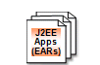
Note about installation WebSphere and supplements (IHS …)
Full install of GA WebSphere, IBM HTTP Server and Plug-In IHS
Install feature Web Services (According to ProgDir, the Feature Web Services are mandatory)
Install Fix Pack (recommended by ProgDir is FP17)
Creating Web Server via IBM Console administration
Deploy application V6 (ear or war)
WebSphere 6.1.0 IHS
V6.1
WebSphere6.1.0.17
Java1.5.0 SR7
(CHECK SR)
FP17

Slide 39
Note about installation WebSphere and supplements (IHS …)
These steps show that your installation Web Server, Plug-In and Websphere are working properly.
First, test your HTTP server by browsing
http://<machine_name>/ (we assume that the port HTTP is 80)
Finally, Test your installation by browsing the URL
http://<machine_name>/PlantsByWebSphere

Slide 40
Note about installation WebSphere and supplements (IHS …)
Generate and Propagate the Plug-In IHS on your HTTP Server
Checking <httpd.conf > File
Checking Plug-In xml <plugin-cfg.xml> File
LoadModule was_ap20_module /appsrv/IBM/HTTPServer/Plugins/bin/mod_was_ap20_http.soWebSpherePluginConfig /appsrv/IBM/HTTPServer/Plugins/config/enoviaweb/plugin-cfg.xml
</ServerCluster> <UriGroup Name="default_host_server1_<Machine_Name>Node01_Cluster_URIs"> <Uri AffinityCookie="JSESSIONID" AffinityURLIdentifier="jsessionid" Name="/PlantsByWebSphere/*"/> <Uri AffinityCookie="JSESSIONID" AffinityURLIdentifier="jsessionid" Name="/PlantsByWebSphere/docs/*"/> <Uri AffinityCookie="JSESSIONID" AffinityURLIdentifier="jsessionid" Name="/ematrix/*"/> </UriGroup>

Slide 41
Note about ENOVIA V6 Server – Web Services -
Some Centrals are needed the Web Services such as Requirement central
Update mxEnv.sh to point the WebSphere Application
Stop and start the WebSphere Server
Now compile JPO via mql command (it’s important to use this one located in RMI Server)
Append these lines to the MX_CLASSPATH: [WebSphere_rep_installedApps]/ematrix.ear/ematrix.war/WEB-INF/lib And add these 2 variables: MX_SERVICE_PATH=[WebSphere_rep_installedApps]/ematrix.war/WEB-INF/classes MX_SERVICE_ADMIN=http://myV6server/ematrix * In our case : [WebSphere_rep_installedApps] = /appsrv/IBM/WebSphere/AppServer/profiles/AppSrv01/installedApps/ev6tech1Node01Cell
mql>set context user creator; mql>compile program * force;
You should not see any compile errors

Slide 42
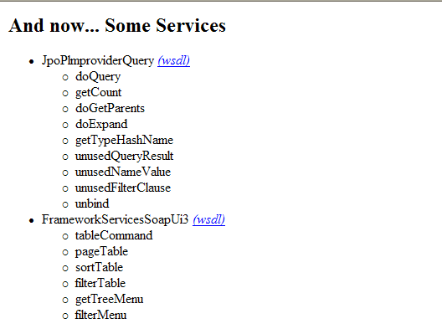
Note about ENOVIA V6 Server - Web Services -
Check your installation: Browser the web http://myV6server/ematrix/services
In the services listing, confirm the addition of Web services

Slide 43
Note about ENOVIA V6 Server - Web Content static -
Static Page Content
This technique is relevant in environment WAN using CBP (Web Interface) in order to reduce bandwidth between the IHS component and Application Server. The Web server servers static content page such as jsp etc…
Web Server
Application Server
Client
Static Page Content

Slide 44
Note about ENOVIA V6 Server - Web Content static -
Unzip ematrix_static.zip in the document root directory of your Web server
Change the parameter <documentRoot> which entry is located in httpd.conf
Adding an entry under <UriGroup Name=> in Web server’s file plugin-cfg.xml :
<Uri Name="/ematrix/*/*.jsp"/> <Uri Name="/ematrix/servlet/*"/>

Slide 45
Tomcat
Ensure you have installed Java 6 SDK
Download Tomcat from page shown in Chapter 1
Modify the startup.sh script to reflect the installation directory
Modify the setclasspath.sh to reflect the installation directory and the JAVA_HOME
Add a manager and admin to the tomcat-users.xml file
Add “. $ENOVIA_HOME/serverRMI/scripts/mxEnv.sh” to the end of the startup.sh file
Start Tomcat using startup.sh
Use a browser, go to http://localhost:8080 , select Manager and login with the user/password defined in tomcat-users.xml
Use the Deploy Web Application and deploy the ematrix.war file from $ENOVIA_HOME/serverRMI/distrib

Slide 46
Apache for Static Content
As described on slide 45 but here you also need to install Apache and configure it to front-end Tomcat
Use mod_jk to connect them
Now you can access ENOVIA on port 80 rather than 8080

Slide 47
Multiple Application Servers
Using WebSphere, you can create new profiles and then use a loadbalancer to distribute transactions to them
Using Apache/Tomcat, mod_jk can be configured to load-balance across several Tomcats (note that you need to copy the Tomcat directory each time and ensure that all the .bat / .sh files in the bin directory reflect the new path

Slide 48
ENOVIA Installation
Once your Web and Application Servers are installed, install the ENOVIA Software in the following order:
Studio Modeling
LiveCollaborationServices
LiveCollaborationServicesBPS
EngineeringCentral
Other Centrals…
…
LiveCollaborationVPM
Run the war_setup program to build the war and ear files (war for Tomcat and ear for WAS)
You may want to recompile all the JPOs using…
WARNING: make sure that the emxSystem.properties file is correct…

Slide 49
Agenda
1
Installation Overview
2
DB installation and Setup
3
ENOVIA Application Server Installation
4
FCS installation and Setup
5
Conferencing Server Installation
6
3D Index Search Server Installation
7
Advanced Search Server Installation
8
Client Installation

Slide 50



FCS Installation and Setup
Prerequisites:
Web Application Server (Tomcat or WAS)
Installation of ENOVIA Live Collaboration Server (no bootstrap)
SITE
HTTP
MCS
DB
FCS
FTP
FCS
LOCATION 2 (Remote Site)
ENOVIA Live Collaboration Server
SITE
LOCATION 1 (Main Site)
FCS
ear/war
Application Server Code

Slide 51
FCS Installation and Setup
Start
1
2
Remote site with only one tomcat installation
ENOVIA Live Collaboration Server installation
Tomcat Installed
Collaboration server installed
Creation & Deployment of a Web App. Server
The file collaboration server is ready
On the remote site
3
End
ENOVIA V6 installation
Platforms
+
Centrals
Setup in
ENOVIA V6
The file system is now known to the server
On the server

Slide 52
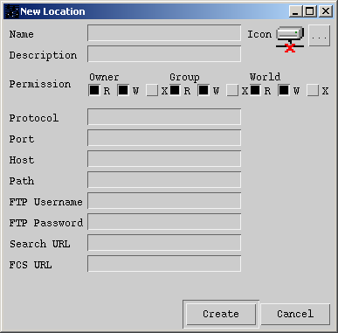
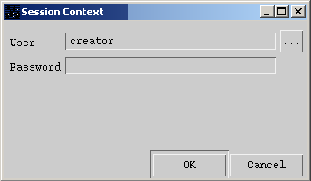
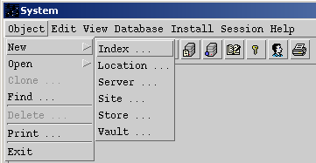
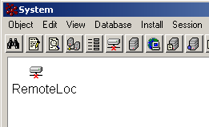
FCS Setup on Server
On the server, launch the “system” application
cd<DESTINATION>/matrix/scripts/
./system
Connect as creator
Create a new location
RemoteLoc
file
<FCS_HOST>
<Client_Destination>\Location
http://<FCS_HOST>:<PORT>/ematrix

Slide 53
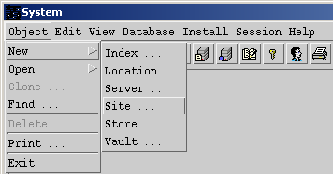
FCS Setup on Server
Create a new site “RYAN” by adding RemoteLoc
RemoteLoc

Slide 54
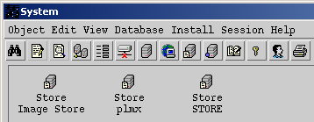
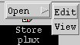
FCS Setup on Server
Find and edit the plmx STORE object
Add the new location to plmx STORE
Host_Name
<MCS_STORE_Path>
RemoteLoc

Slide 55
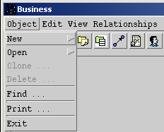
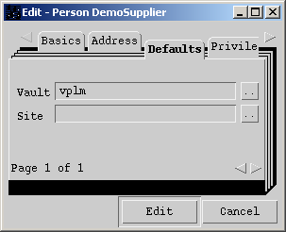
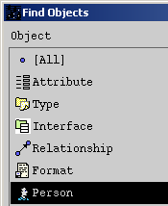
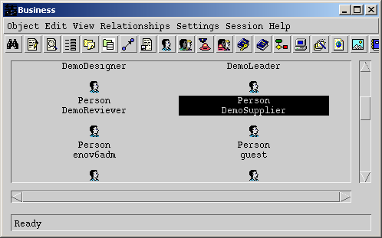
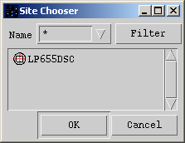
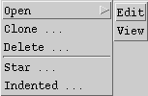
FCS Setup on Server
Assign a user to the FCS
Launch “business” application
cd<DESTINATION>/matrix/scripts/
./business
Connect as creator
Find and edit your user “DemoSupplier” Person object
Change Site value to appropriate one
RYAN

Slide 56
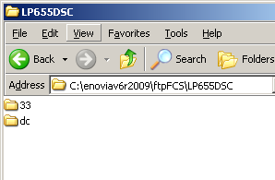
FCS Setup on Server
Check FCS
First make sure you get output from http://localhost/ematrix/servlet/fcs/about, then…
Re-Start Application Server on the server
If running in your PC, check that your ftp server is online
Launch CATIA with the user associated to the FCS
Create a part/representation
Save it (Propagate)
Verify on the FCS server that the data is created
<Client-Destination> \Store

Slide 57
Agenda
1
Installation Overview
2
DB installation and Setup
3
ENOVIA Application Server Installation
4
FCS installation and Setup
5
Conferencing Server Installation
6
3D Index Search Server Installation
7
Advanced Search Server Installation
8
Client Installation

Slide 58
Installation
Login as root
Install Domino
Login to system as domino user
Configure Domino Database
Install Domino patches (cumulative fixes, etc)
Relogin as root
Install Sametime and patches
Configure users in Domino
Start Sametime
Connect inside CATIA client

Slide 59
Note about installation Lotus/Domino
Create a domino user as member of the domino group
Full install of GA Domino + the fix pack
Configuration of th Domino server – note that you MUST LOG OUT as root and login as root for this step
Full install GA Lotus Sametime 7.5.1
Install cumulative pack CF1
V7.0.3
V7.5.1
Lotus Sametime Srvv7.5.1
Lotus Sametime Srv v7.5.1 CF1
CF1

Slide 60
Next Steps
If on UNIX or running Domino on a separate server than the Notes client, copy the cert.id file from the server to the Windows client
Install c88rdna.exe - IBM Lotus Notes Designer Admin Clients 7.0.1
If running on the same server as WebSphere or Apache, you must change the HTTP port that Domino’s web server runs on so that it doesn’t conflict with the IHS port
In the Domino server address book (People & Groups in the Administration panels), you must Register the users that will use Sametime using their shortname (for login), a password, the Sametime server for Messaging, their email address
In the CATIA client, you must set the CLASSPATH to include the client jar files and configure CATIA to point to your Sametime server

Slide 61

Collaboration configuration Overview
Windows user ids must be different !
My_Desktop 3
XP Client
ENOVIA V6
Application server
My_Desktop 1
XP Client
HTTP
Peer to Peer
Collaboration
Peer to Peer
Collaboration
My_Desktop 4
XP Client
My_Desktop 1
XP Client
Peer to Peer
Collaboration
OEM Site
Supplier Site

Slide 62
Multiple interfaces client
If the client host has several network interfaces (for example, one Ethernet and one Wifi interface), you will have to configure the peer-to-peer collaboration.
In case of a multiple network adapters active at the same time, you must:
Create a file containing the following lines:
CATP2PTCPEndPoint|"IP address of the Adapter that will be used for the peer-to-peer communication"|0
CATP2PMultiCastEndPoint|224.0.1.85|0 Important: It is mandatory to end the file with a new line.
Add the following variable in the environment file:
CATP2PConfig="path and filename of the previously created file“
export CATP2PConfig

Slide 63
Agenda
1
Installation Overview
2
DB installation and Setup
3
ENOVIA Application Server Installation
4
FCS installation and Setup
5
Conferencing Server Installation
6
3D Index Search Server Installation
7
Advanced Search Server Installation
8
Client Installation

Slide 64
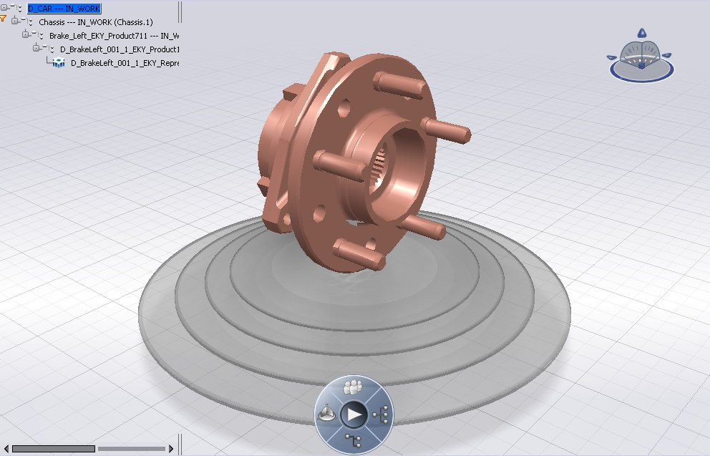
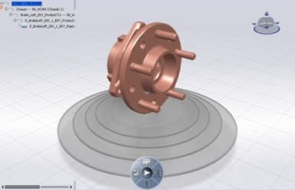
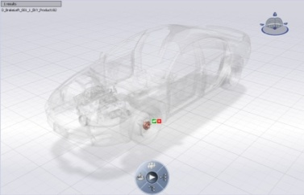
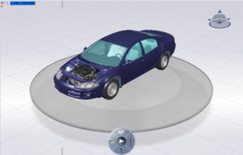
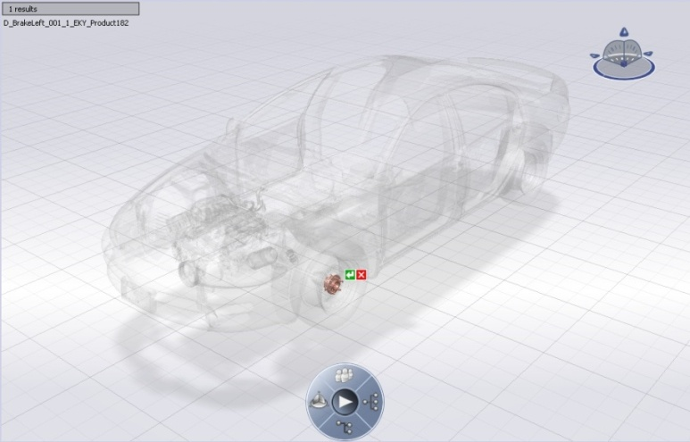
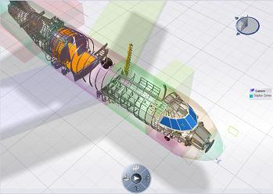
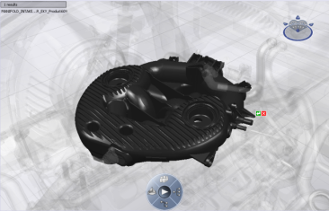
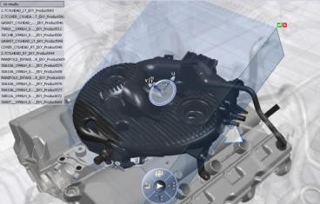
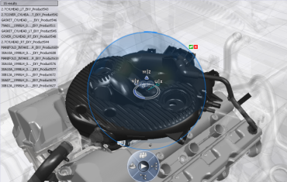
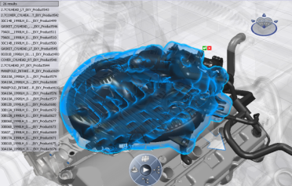
Introduction - Current High Level Queries in 3DSearch
3DSearch Goal: Whatever model size & product structure in a given configuration… retrieve 3D information in real-time!
Propose high level queries in real time
Pick Query
Box Query
Sphere Query
Proximity Query
Zone Query
Single Click!
Zone Query
3DSearch based on 3DIndex technology
3DIndex sever = Database-compiled view
Allows quicker search than a classic search in a database
Search on compiled geometry
The 3DIndex data is organized differently than in the database
Pick Query
Box Query
Sphere Query
Proximity Query

Slide 65

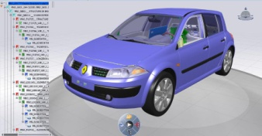
Introduction - General principle of 3D Indexing
3D Index Admin Server
compilation
Rep A
Rep B
Rep C
references instances representations effectivities
Geometrical representations and metadata
3D Index Files
Two Products
3D Index Admin Server
During build-time -> Compile 3D Data in FCS to 3D Index Files
Data compiled type
Product structure data
representations
Results
Index files where the size depends on :
wet area (external surface of the products)
references /instances number
Configuration complexity
3D Index Server
During runtime ->3DSearch client requests resolution of 3D Query
3DIndex Server analyses the 3DSearch requests from the index files
returns a list of IDs of the representations

Slide 66



Buildtime - Architecture
MCS
3D Index Server
FCS
HTTP
3D Index Files
Saves the index files on the 3D Index Server disk
PLMIndexAdmin
Mechanism
The PLMIndexerAdmincontacstthe MCS/FCS
The data are sent to the PLMIndexerAdmin and compiled
The index files are generated in the 3D Index Server repository
HTTP protocol between MCS/FCS and PLMIndexerAdmin
The PLMIndexerAdmin launched by a user declared on the machine hosting the 3DIndex Server
This user must have the rights :
To launch a process
To write in the index files repository

Slide 67
Licensing for 3DIndexing
Licensing Types
Nodelock is only type supported. It’s a LUM Version 5 product Key.
What to Order thru the Notes License database:
5679-PIX
Where to put the Nodelock File(s):
AIX →Import using CATNodeLockMgt
Windows →Import using CATNodeLockMgt, if Dir does not exist, create it at : C:\Documents and Settings\All Users\Application Data\IBM\License Use Management\nodelock
Notes:
We already have a short overview of V5 PLM SOA. We will now zoom on the third layer and on V5 unique PLM meta-model
This model allow to describe any hierarchical structure and any topology. All this model is based on mathematical foundation
As we can see, all V5 model discipline application are based on this meta-model, allowing
1/a perfect communication with each others
2/to inheriting from PLM core functionalities: versioning, configuration, change management, collaboration,…

Slide 68
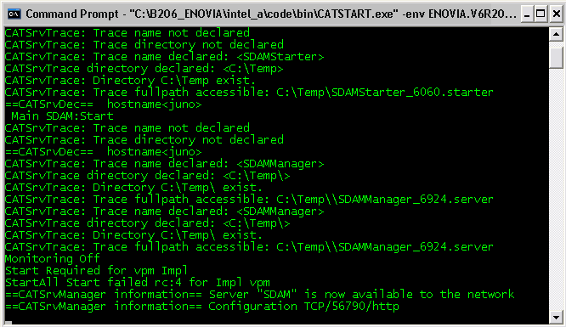
Configuring the Indexing Tool
Start the SDAM process
Step 1
C:\B206_ENOVIA\intel_a\code\bin\CATSTART.exe -env ENOVIA.V6R2009x_ENOVIA.B206
-direnv “C:\B206\CATEnv” –run “C:\B206\intel_a\code\bin\SDAMStarter -Start"
You will see the SDAM message saying it’s running on port 56790

Slide 69
Environment Checks
Check if the SDAM is running
ps -edf | grep -isdam
<3DIndexInstallPath>CODES/aix_a64/code/bin/SDAMMain -supervisorMode 0
Stopping the SDAM
cd<3DIndexInstallPath>/CODES/aix_a64/code/command
catstart -env ENOVIA.V6R2009x.B206 -direnv<3DIndexInstallPath>/CATEnv -run "SDAMStarter –Stop”
CATEnv file modifications
cd<3DIndexInstallPath>/CATEnv
vi ENOVIA.V6R2009x.B206.txt
Replace
CATUserSettingPath=\$USER_HOME/CATSettings/DSKEY_RELEASE_LEVEL/Authoring
By
CATUserSettingPath=<3DIndexInstallPath>/CATSettings/\$USER_HOME/DSKEY_RELEASE_LEVEL/Authoring
Starting PLMIndexAdmin
Cd<3dIndexInstallPath>/code/command
catstart -env ENOVIA.V6R2009x.B206 -direnv<3DIndexInstallPath>/CATEnv -run PLMIndexAdmin

Slide 70
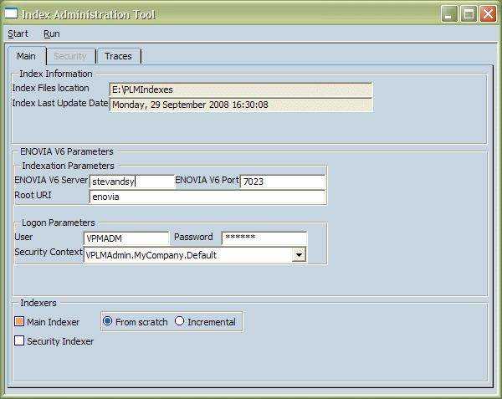
Buildtime - tools 1/2
Graphical user Interface : PLMIndexAdmin
Error Tracing will show up in this tab
Index Files repository
/home/data/IndexServer/Index
Last indexation date
<Host_Name>
Connection parameters to the MCS
8081
Connection PLM Index user defined into the MCS
User connexion
Indexer to compile the product structure and geometry
Rebuild all indexes or just incremental build
Indexer to create index security

Slide 71
Buildtime tools 2/2
PLM Index Admin information saved in a file
IndexSettings.idx in the 3D Indexes Directory specified in the previous dialog box
Build automation
PLMIndexAdminPlayertool
Run the 3DIndex compilation based on IndexSettings.idx parameters file
PLMIndexAdmin workload
Recommended to run the PLMIndexAdmin on a separate machine from the 3DIndex server to preserve 3DIndex server performance

Slide 72
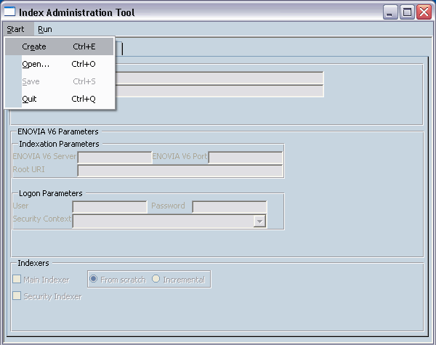
Configuring the Indexing Tool
Start the PLMAdminIndexer tool
Step 2
“C:\B206_ENOVIA\intel_a\code\bin\PLMIndexAdmin.exe
You need to create an input IDX file, Select Start/Create
Notes:
72

Slide 73
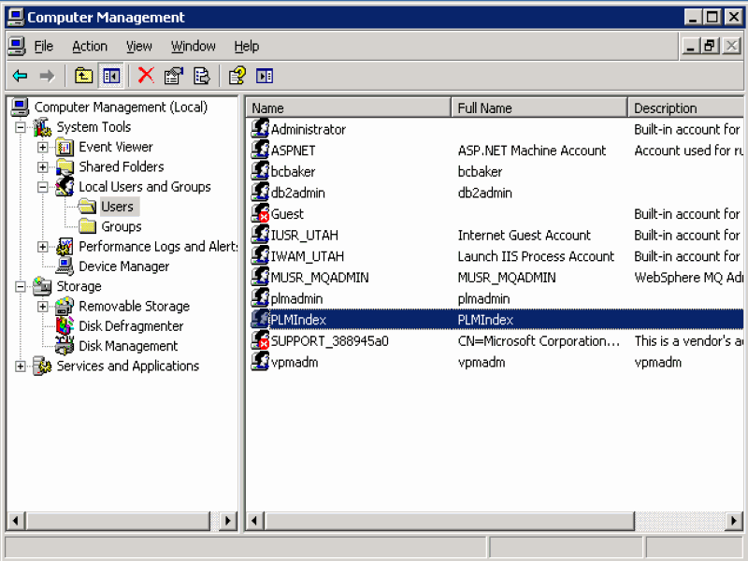
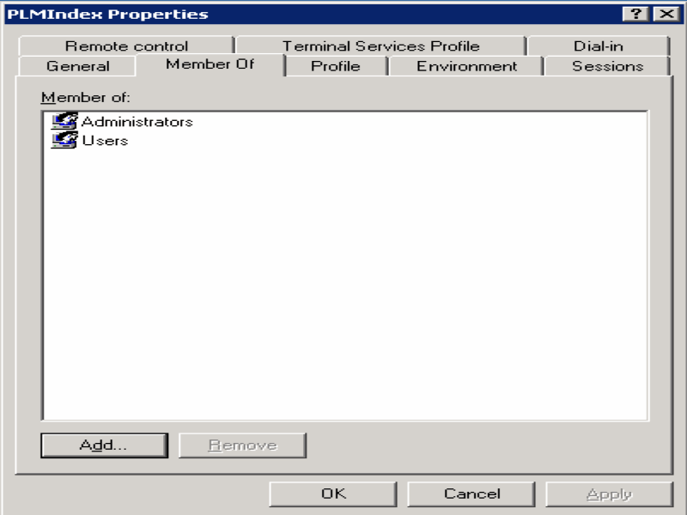
Configuring the Indexing Tool
Leave the PLMAdminIndexer tool running
Step 3
Create a user that will access the Indexing process. First you must create a
Windows User, and add it to the Administrators group.
Notes:
73

Slide 74
Configuring the Indexing Tool
Leave the PLMAdminIndexer tool running
The next group of slides prepare your Indexing Userid
Create a Matrix Userid, and give it a VPLMAdmin.MyCompany.Default role
You must first update Test Everything’s priviledges to add Admin rights
You must Register all of the needed V6 VPLM role definitions in
Admin Tools/Property Registration/Property Type
Notes:
74

Slide 75
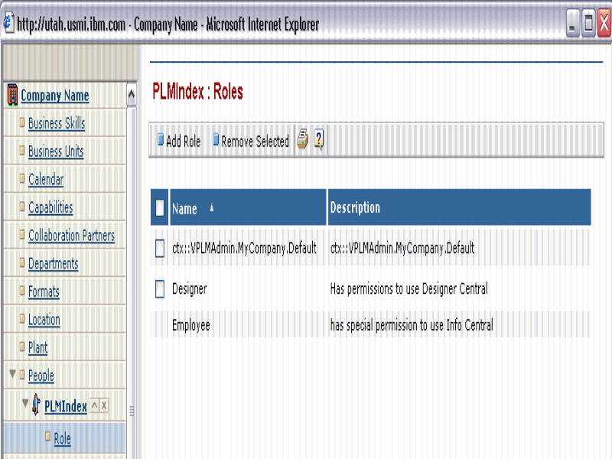
Configuring the Indexing Tool
Leave the PLMAdminIndexer tool running
Step 4
Create a Matrix Userid (PLMIndex), and give it a VPLMAdmin.MyCompany.Default role
Notes:
75

Slide 76
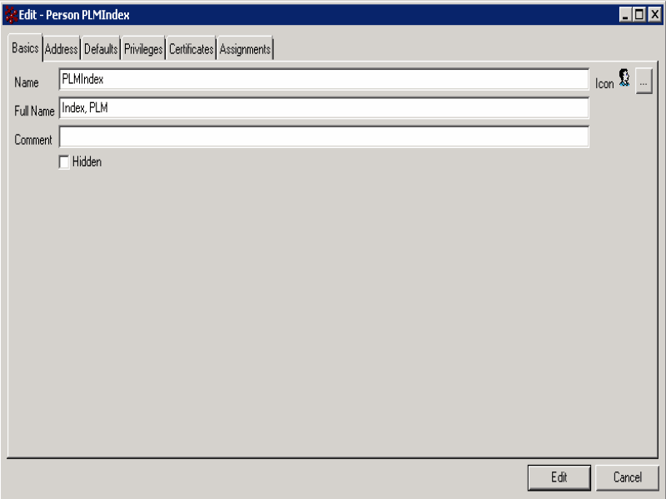
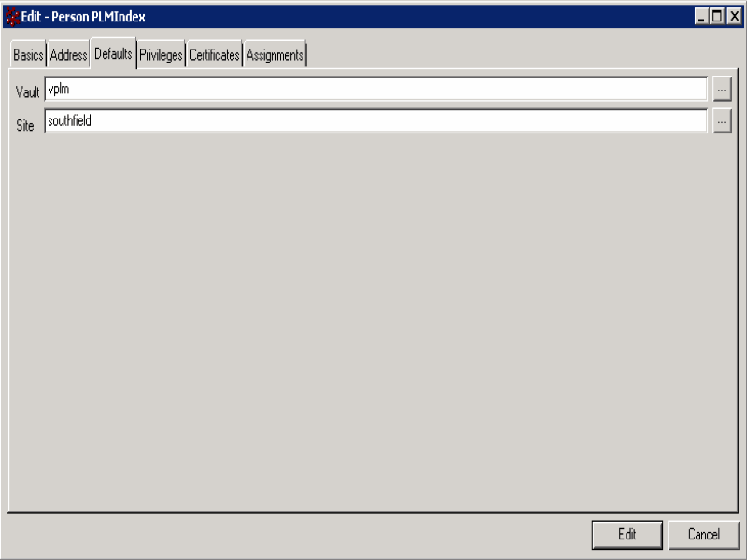
Configuring the Indexing Tool
Leave the PLMAdminIndexer tool running
Step 5
Change the Default Vault for your new User (PLMIndex) in Business to ‘vplm’
Notes:
76

Slide 77
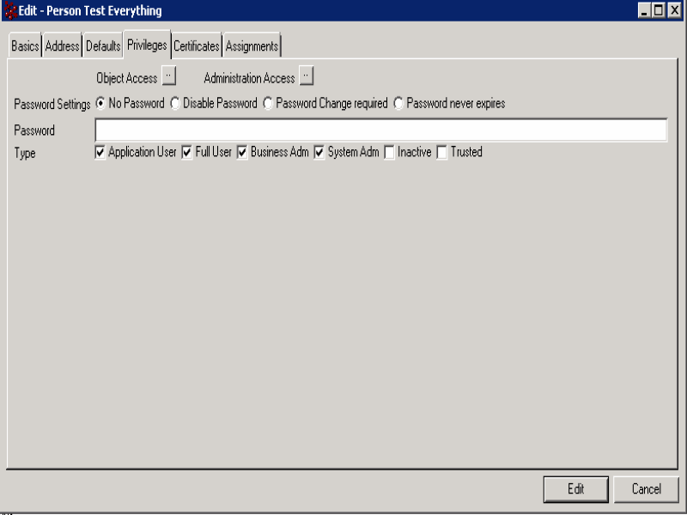
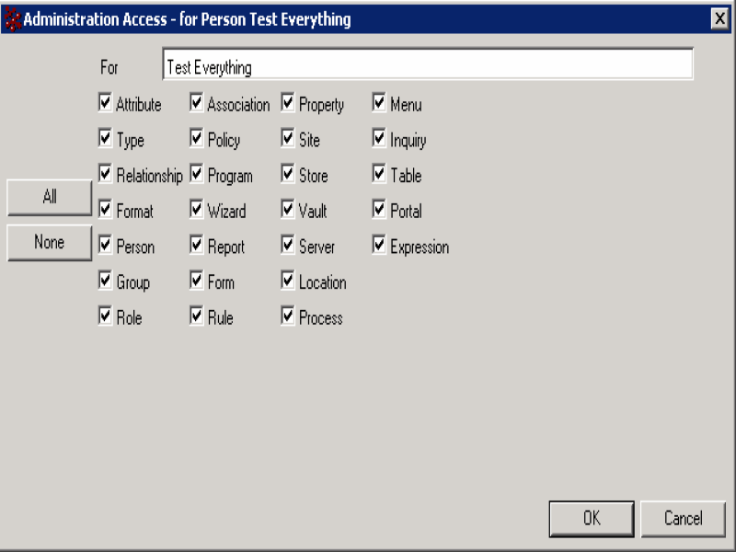
Configuring the Indexing Tool
Leave the PLMAdminIndexer tool running
Step 6
You must first update Test Everything’s privileges to add Admin rights
Using ‘Business’
Notes:
77

Slide 78
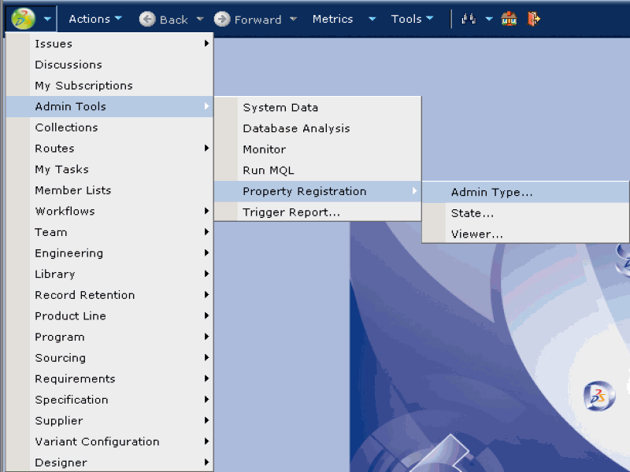
Configuring the Indexing Tool
Leave the PLMAdminIndexer tool running
Step 7
You must Register all of the needed V6 VPLM role definitions in
Admin Tools/Property Registration/Property Type
Login as Test Everything
Notes:
78

Slide 79
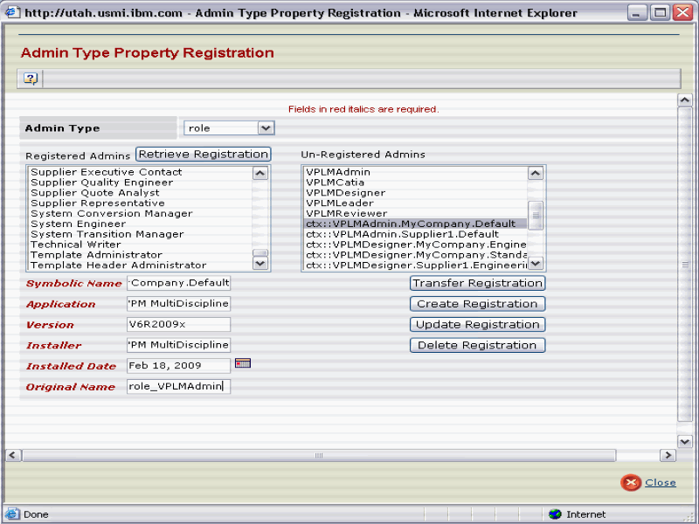
Configuring the Indexing Tool
Leave the PLMAdminIndexer tool running
Step 7
You must Register all of the needed V6 VPLM role definitions in
Admin Tools/Property Registration/Property Type
Notes:
79

Slide 80
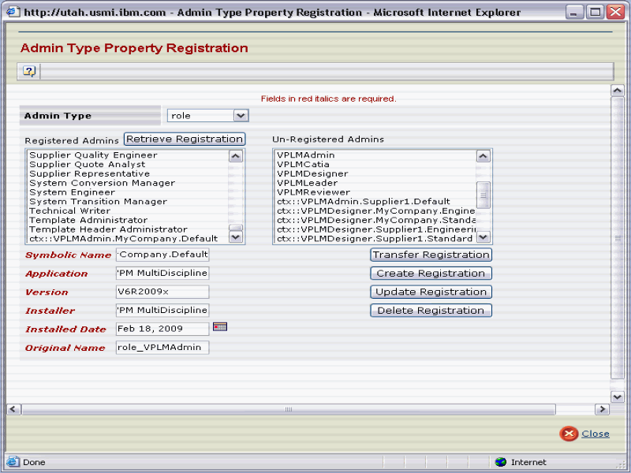
Configuring the Indexing Tool
Leave the PLMAdminIndexer tool running
Step 7
You must Register all of the needed V6 VPLM role definitions in
Admin Tools/Property Registration/Property Type
VPLMAdmin Role is now registered
Notes:
80

Slide 81
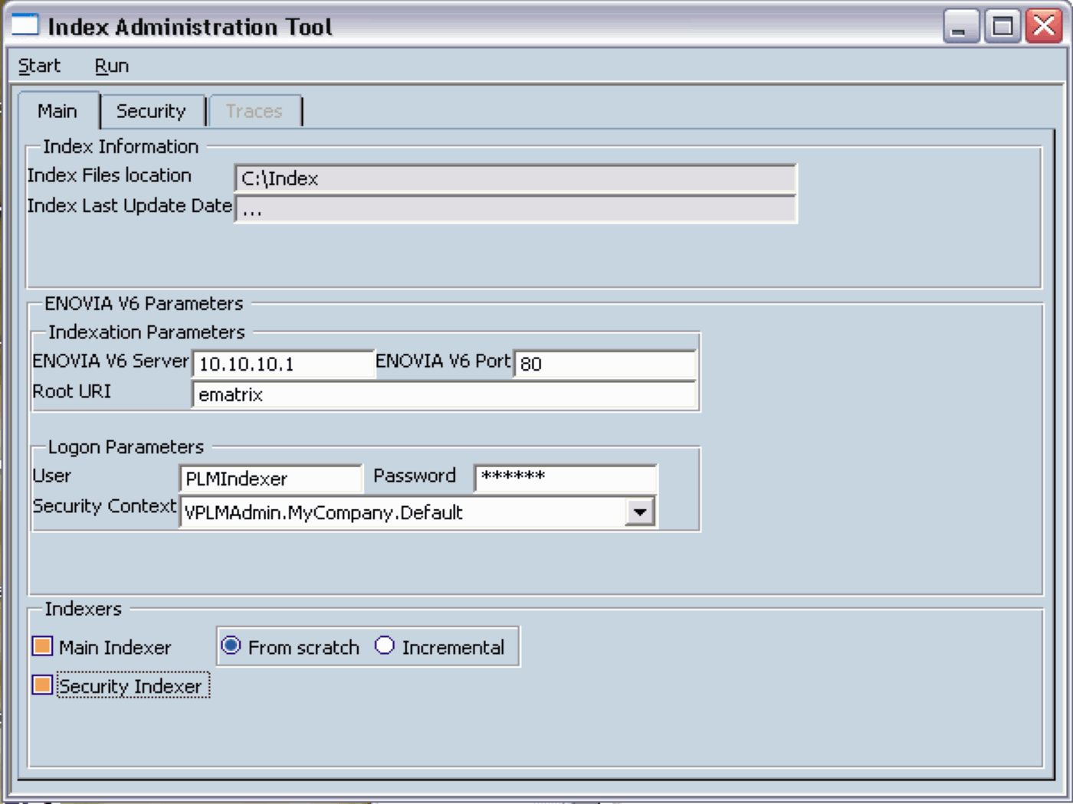
IndexAdmin Parameters
Step 8
Navigate to a Directory to store the Index files, provide the details of the
Connection, select your role, and choose the tabs on what to Index.
When complete, press Start/Save

Slide 82

IndexAdmin Parameters (continued)
Step 6
Press the Security Tab, Add a simple Security enabled attribute for References,
like V_organization = ‘MyCompany’.
When complete, press the Instances Tab

Slide 83

IndexAdmin Parameters (continued)
Step 7
On the Security Tab, Add a simple Security enabled attribute for Instances,
like V_organization = ‘MyCompany’.
When complete, save the Configuration (Start/Save)

Slide 84

IndexAdmin Parameters (continued)
Step 8
Go back to the ‘Main’ Folder, and then press ‘Run now’

Slide 85

BuildTime – 3DIndex Security
Representation Visibility determined by rules
Rules are compiled at BuildTime
The rules are built regarding the attributes saved in the file attributes index
Resulting security index is used at RunTime
PLM Object Attributes
(V_user = $CurUser&V_maturity = “IN_WORK”) |
(V_project = $CurProject&V_maturity = “SHARED”) |
(V_maturity = “RELEASED”)
Sample:
Parts with IN_WORK maturity can be seen only by the owner of the part,
Parts with “Shared” maturity can be seen by users working on the same project,
Parts with Released maturity can be seen by everyone
User Connection parameters

Slide 86

IndexAdmin Parameters (continued)
Step 9
A new tab is created called ‘Traces’. You can the see the logs here.
Press OK to finish

Slide 87

IndexAdmin Parameters (continued)
Step 10
You can exit, by pressing Start/Quit.
Initial Indexing is complete

Slide 88

Doing a Partial Indexing
Step 1
Start the PLMIndexAdmin process again (Page 7)
Open the IDX file you created in the previous step (Full Indexation)

Slide 89

Doing a Partial Indexing (continued)
Step 2
Select Start/Open and navigate to your Index directory.
Open the IndexSettings.idx file.
Notes:
89

Slide 90

Doing a Partial Indexing (continued)
Step 3
Select Start/Open and navigate to your Index directory.
Open the IndexSettings.idx file.
Here, we will toggle the radio button to ‘Incremental’
Notes:
90

Slide 91

Doing a Partial Indexing (continued)
Step 4
Select Start/Open and navigate to your Index directory.
Open the IndexSettings.idx file.
Here, we will toggle the radio button to ‘Incremental’
Notes:
91

Slide 92
Doing a Partial Indexing (continued)
Step 5
After changing the Radio button from ‘Scratch’ to ‘Incremental’
Next, we will save this configuration as a ‘Incremental’ IDX file.
Notes:
92

Slide 93

Doing a Partial Indexing (continued)
Step 6
After changing the Radio button from ‘Scratch’ to ‘Incremental’,
select ‘Start/Save’
Next, we will give it a new name
Notes:
93

Slide 94
Doing a Partial Indexing (continued)
Step 7
After changing the Radio button from ‘Scratch’ to ‘Incremental’,
select ‘Start/Save’
This will overwrite the existing IDX file. If you open it again, you
Will see that’s it set to ‘Incremental’
Notes:
94

Slide 95
Setting up a Script to run the Partial ‘Incremental’ indexing
@echo off
rem ******************************
rem * Run 3D Indexation in batch *
rem ******************************
set bin_path=C:\B206_ENOVIA\B206\intel_a\code\bin
set indexsettings_file_path=C:\Index\IndexSettings.idx
set flag="-file"
%bin_path%\PLMIndexAdminPlayer %flag% %indexsettings_file_path%
rem
Save it as a ‘bat’ file, and use it with the Windows Task Scheduler to run
Notes:
95

Slide 96
Index files computation
Index session
The index session has been saved in a IndexSettings.idx file, under the path :
<3DIndexInstallPath>/Index
Index files generation
Launch the PLMIndexAdminPlayer
cd <3DIndexInstallPath>/CODES/aix_a64/code/command
catstart -env ENOVIA.V6R2009x.B206 -direnv <3DIndexInstallPath>/CATEnv -run “<3DIndexInstallPath>/CODES/aix_a64/code/bin/PLMIndexAdminPlayer –file “<3DIndexInstallPath>/Index/IndexSettings.idx”

Slide 97




User client setup
Launch a CATIA V6 client session
xxx
xxx
xxx

Slide 98


User client setup
Connexion parameter to contact the the IndexServer :
Host Name = …
Port number = …
A user declared on the index server = IndexAdmin
Index files location = <3DIndexInstallPath>/Index
xxx
xxx
xxx
Test the connexion with the 3DIndex server

Slide 99


Setting up the CATIA V6 client to access the Index data
This signifies that the Index data is being read
Notes:
99

Slide 100
Buildtime - Results
At the end of the buildtime
Index files
Index Instance
Index containing the product structure (instances/ references) compiled from the database
Index Geometry
Index containing the compiled geometry
Index Attributes
Coming from the database, to secures the index sever data
Index Security
Index managing the representations access in the index server
the rules are built from attributes saved in the attributes index

Slide 101

Buildtime – Production Runtime
Process Creation
From scratch
Incremental
Index files creation and use of 3DIndex in parallel
2 versions of 3D Index files coexist
One active for concurrent requests
A second for ongoing or old compilation
3D Index Files Switch
At the end of the compilation, the new index files are set active
Switch is tranEnsure the proper execution of the request when the index is switched to the new one
sparent for the user

Slide 102

Process Overview

Slide 103



Runtime - Architecture
HTTP connection between
Client 3D Search/3D IndexServer
Client 3D Search/MCS-FCS
SDAM server
Master process managing the son processes : CATPLMIndexServer
For a 3DSearch request, a processCATPLMIndexSeveriscreated
The CATPLMIndexServerdeal with the requestcomingfrom 3DSearch Client
At the end of the request, the CATPLMIndexServer process is :
Either assigned to a new request
Either killed when is timeout is over
The SDAM isstartedautomaticallyat the end of the installation.
When the SDAM iskilled, it must berestartedmanually
The SDAM must have the rights to :
To createprocesses
To « fork » owners
MCS
FCS
HTTP
SDAM
Clients
3DSearch
3D IndexServer
Requests
Clients
3DSearch
Stateless transactions
3D Index server
SDAM
Requestsdispatch
Number of process configurable
TimeOut per process
CATPLMIndexServer
Processes pool
Common Memory Area shared by all CATPLMIndexServerprocesses

Slide 104
Best Practices – BuildTime
First: build the terminal NavRep
To optimize the performance at RunTime
Not mandatory but advised
Take care of representations attached manually to intermediate nodes
Stops the indexing process under this node
Only use them if absolutely necessary
3DIndexer (BuildTime) multi-threaded
Take advantage of the multi-core machines
At least 2 GB of memory
BuildTime and RunTime machines must be Endian- compatible
Both machines need on AIX or they both must be either RHEL5 or Windows

Slide 105
Best Practices - RunTime
Improve I/O access to Index files on disks (3D Index server)
Use fastdisks, fast I/O bus
Latency and bandwidthcriteria
In particular performance willbesub-optimalwhenindex data is not in yet in memory or whenmemoryisunder-sized
Size the system memoryaccordinglywith 3DIndex files size (on disk)
Memory = 3DIndex files size + 2GB
Request performance depends on :
Request type and complexity
Box query (cheap) versus Proximityquery (costly)
Product structure depth

Slide 106




Typical Architecture
3D Index Build Server
3D Index Server
3D Index Queries from CATIA V6
MCS
3D Index Files Stored on Common Storage Bay
FCS
3D Index Builds from data in FCS
Client

Slide 107
Agenda
1
Installation Overview
2
DB installation and Setup
3
ENOVIA Application Server Installation
4
FCS installation and Setup
5
Conferencing Server Installation
6
3D Index Search Server Installation
7
Advanced Search Server Installation
8
Client Installation

Slide 108
Autonomy IDOL
DiSH is the license server
IDOL is the index server
FSF is the content fetcher
DiSH and IDOL and FSF must be installed on the Advanced Search Server (or MCS if no separate machine is deployed
FSF must be deployed on each FCS
They are connected via…
Create a baseline index
Create a cron job for periodic indexing
Modify emxSystem.properties to use Query and enable Advanced Search using Autonomy in the ENOVIA client applications
Verify the indexes using…

Slide 109

Advanced Search

Slide 110
Getting Started
Ensurethereisat least 1GB of free space
Install fromLiveCollaborationServer CD, thenrun the startup scripts
startAdvancedSearchServer.sh
startAdvancedSearchFileSystemFetchServer.sh
youcan check it’s running by lookingat port 9000/action=help
Build Index
[matrix@localhost scripts]$ mql
MQL<1>set context user creator;
MQL<3>set system searchindex file $ENOVIA_HOME/serverRMI/STAGING/ematrix/config.xml;
MQL<4>startsearchindex mode FULL;
MQL<5>quit;
Modify $ENOVIA_HOME/serverRMI/STAGING/ematrix/properties/emxSystem.properties:
emxFramework.FullTextSearch.QueryType=Indexed

Slide 111
Getting Started (2/2)
Rebuild and redeploy WAR file
Finally, set up a partial index via cron :
Use crontab –e
5 * * * * /dist/matrix/rmi/scripts/startPartialSearchIndex.shcreator
10 * * * * /dist/matrix/rmi/scripts/startPartialSearchIndex.shcreator
15 * * * * /dist/matrix/rmi/scripts/startPartialSearchIndex.shcreator
20 * * * * /dist/matrix/rmi/scripts/startPartialSearchIndex.shcreator
25 * * * * /dist/matrix/rmi/scripts/startPartialSearchIndex.shcreator
30 * * * * /dist/matrix/rmi/scripts/startPartialSearchIndex.shcreator
35 * * * * /dist/matrix/rmi/scripts/startPartialSearchIndex.shcreator
40 * * * * /dist/matrix/rmi/scripts/startPartialSearchIndex.shcreator
45 * * * * /dist/matrix/rmi/scripts/startPartialSearchIndex.shcreator
50 * * * * /dist/matrix/rmi/scripts/startPartialSearchIndex.shcreator
55 * * * * /dist/matrix/rmi/scripts/startPartialSearchIndex.shcreator
0 * * * * /dist/matrix/rmi/scripts/startPartialSearchIndex.shcreator
This willbequickerthanuploading a new instance.

Slide 112
Useful MQL Commands
set system searchindex file /…./config.xml Setup step
statussearchindex Shows number of objects in eachvaultindexed.
startsearchindex mode FULL Index wholedatabase – slow.
stop searchindexvault “eService Production” Stop anyindexing on vault. Usefulishung.

Slide 113
Useful URLs
http://<host>:9000/action=xxxx
action=GetRequestLog - Tracks all access to the Server
action=Query&text=Night* - Search default DB for Night*
action=CategoryFind&name=Feature - ValidateFeatureisvalidCategory
action=GetStatus - Return number of documents, etc
Admincommands use a different port number 9002
http://<host>:9002/action=xxxx
action=GetConfig
[Databases] section isuseful to identifydatabasenamese.g. AdvancedSearchDB0
action=GetStatusInfo
Form Vs Navigation mode on IndexedSearch
In “Search User Interface” (pg 122 of 2009X) of Business Process Server Admin guide.
emxPlatformFullTextSearchFormBased=false // true = Form, false = Nav mode.

Slide 114
Troubleshooting
DiSHisthatitneeds 1Gb free disc space the whole time, not justatinstall. Symboliclink /dist/matrix/rmi/DiSH and IDOL to a place withloads of room.
DiSH and IDOL must be running beforeperformingany MQL, etc.
http://<hostname>:9000/action=help
This should display a menu page. If itdoes not appearthereis a problemwithAutonomy. Seeabove.
MQL >search index error (System Error: #5000001: Failed to executeAciAction to server.
AgainthismeansDiSH or IDOL are not running correctly - DiSH and IDOL must be running before running start index.
System Error: #5000001: config contains duplicate BOTYPE <<Location>>
Remove duplicate BOTYPE Location tag fromconfig.xml.

Slide 115
Troubleshooting, ctd
“CannotfindSymbol” message / Egg timernever stops spinning on search Panel.
component.jar in webapps/WEB_INF/classes is not the latest. See the related compile problem for more detailsbelow.
Search Panel only has twoattribute on general page (date ones). No results are returnedwhendatabaseis good (e.g. Vs Query&text). Panel does not morph to different class definitions. This wasseenafter a hot fixinstall.
Reset config.xml to a complete version in mqlusing “set searchindex”. The templateones have verylimitednumber of attributes per class. Maybewrongconfig.xmlwasbeingpointed to.
Rerun a full index.
Searchdoes not findrecentlyindexedobjects.
Check mxtrace.log for “pool size insufficient” error (Oracle). [See MX_CONNECTION_POOL_SIZE section]

Slide 116
THREADPOOL Config
THREADPOOL size
This entry controls the number of threads used to index yourdatabase. It ishighlyrecommendedthatyourthreadpool size isequal to the number of cores on the machine withyour Advanced Search Server. For example, if the machine is a 2 CPU dual coremachine, you have 4 cores and yourthreadpoolshouldbe set to 4.
Yourthreadpool size shouldbereflected in the MX_CONNECTION_POOL_SIZE ENOVIA Live Collaboration Server environment variable. This variable shouldbe set to 2*(1+THREADPOOL). For the exampleabove, this variable wouldbe set to 10. For more information on this setting, see ENOVIA Live Collaboration Server Environment Settings.

Slide 117
Agenda
1
Installation Overview
2
DB installation and Setup
3
ENOVIA Application Server Installation
4
FCS installation and Setup
5
Conferencing Server Installation
6
3D Index Search Server Installation
7
Advanced Search Server Installation
8
Client Installation

Slide 118

V6 Installation Overview - Client
CLIENT
3DLive
CATIA V6, DELMIA V6, SIMULIA V6 …
Thin client via the IE or Firefox

Slide 119
Client installation
ENOVIA medias:
CATIA.intel_a
ENOVIA_VPM.intel_a
ENOVIA_3DLive.intel_a
The installer are very similar to a standard V5 install, you basically take all defaults values.
In the case of 3DLive, connection panel will ask you for some user/passwd information, you simply skip this step.
Download Prereqs from: http://ehngsa.ibm.com/projects/p/phase2-1

Slide 120

Client Prerequisites (Rich connected client)
For details refer to Program Directory. Subject to change
Notes:
RED: Very important to mention the Source.
RED: For some of the pre-req, they are minimum values, need to confirm witch are and with are not…

Slide 121

Client Prerequisites (Browser client)
For details refer to Program Directory. Subject to change
Notes:
RED: Very important to mention the Source.
RED: For some of the pre-req, they are minimum values, need to confirm witch are and with are not…

Slide 122
Platforms OS Middleware – xBOM/Governance
Windows XP 32-bit/64-bit
Windows Vista 32-bit/64-bit
Rich Clients
Windows XP 32-bit/64-bit
Windows Vista 32-bit/64-bit
MacOS X 10.4 Tiger
Linux RH Desktop 32-bit/64bit
AIX 5.3 64-bit
Solaris 10 64-bit
HP-UX 11liv1 64-bit
Web Browser Clients
Internet Explorer IE6/IE7
Firefox 2.0
Mozilla (AIX)
Browsers

Slide 123
Platforms OS Middleware – VPM V6
Windows XP 32-bit/64-bit
Windows Vista 32-bit/64-bit
Rich Clients

Slide 124









V6 Installation Overview - Client Access V6 server
ematrix

Slide 125
Advanced Topics
Cluster Considerations
Separate Crystal Reports Server
Separate Batch Server
Separate xPDM Orchestration Server
…

Slide 126
Troubleshooting
If you accidently destroy your database or there are errors in the VPM install:
Recreate the database with the CRTENOVIA.ksh script
Recreate the enovadm6 schema via the bootstrap with the system command
Reinstall LiveCollaborationServerBPS
Backup the database (db2 backup database enovia to …)
ReinstallLiveCollaborationServerVPM

Slide 127
Thank you

Slide 128
Additional Slides
V6 License Key for other products
Authentication, External LDAP, and Single SignOn

Slide 129
V6 License Key Implementation – other products
ENOVIA Synchronicity
controlled by Macrovision FLEXlm keys
named-user license automatically detects the user’s username on the DesignSync servers
keys are limited to the current release but are backward compatible
3DVIA Composer
controlled by Macrovision FLEXlm keys
for standard product orders - Machine Based (nodelocked) implementation:
Use the “ipconfig /all” command to get a full listing of the 12 digit Mac addresses for all available network adaptors on the machine that 3DVIA Composer is to be installed on
Pick the address for the LAN card that is being used
for products ordered under Special Bid - Concurrent (Shareable) implementation:
Download the FLEXlm server code from:
http://www.3dviacomposer.com/index.php?id=78
Note for FLEXlm keys the request form is somewhat different (from LUM), but the procedure and IBM Key Center contact information to order them is identical

Slide 130
Authentication Concepts
ENOVIA V6 Supports two kinds of Authentication:
Internal Authentication – users are authenticated by ENOVIA V6. Users can be defined:
By the ENOVIA V6 server (default) –or—
In an external LDAP server with a mapping to the same username in the ENOVIA V6 Server
External Authentication – users are authenticated against a Single Sign-On solution such as Tivoli Policy Director or SiteMinderNetegrity or Clear Trust.
Full instructions are location in the ENOVIA V6 Install Guide in the Integratingwith LDAP and ExternalAuthentication Tools Chapter

Slide 131
Internal Authentication with External LDAP
Requirements:
LDAP Directory (OpenLDAP or Active Directory) with existing users
ENOVIA V6 R2009x server with active users having the same name as in the directory – or –
MX_PAM_PERSON_CREATE=TRUE meaning that authenticated users will have their PERSON object created automatically inside ENOVIA V6
Initial binding with a privileged user
Binding as a privileged user means using the DN and password for a specific user. This user is usually an administrator who has the ability to access all the attributes of the users or a subset of users who are designated as ENOVIA Live Collaboration Server platform users.
All following rebinds with a named user
Named user binding means that the system performs all rebinds with the DN associated with the entered username and with the entered password. Use this method for rebinding if your LDAP server or security needs require that the user be authenticated directly against the LDAP directory server.

Slide 132

Details of Binding Process
Live Collaboration

Slide 133
Installation and Setup
Ensure that users are created on both ends (LDAP and ENOVIA Live Collaboration Server) – or – MX_PAM_PERSON_CREATE=TRUE
Configure the matrix.ini (Windows) or mxEnv.sh file (UNIX) to point to the appropriate string for LDAP access
OpenLDAP:
Base DN for users (privileged and named): cn=users,o=cvi.com
Privileged user: uid=wpsadmin
Privileged user password: wpsadmin (encrypted with MQL)
Users recorded as: objectClass=person
User name’s field: uid
Active Directory:
Base DN for users (privileged and named): cn=Users,dc=supplier,dc=com
Privileged user: fstNamelstName
Privileged user password: mypass (encrypted with MQL)
Users recorded as: objectClass=user
User name’s field: sAMAccountName
In RED the main differences between OpenLDAP and Active Directory.

Slide 134
OpenLDAP Example
MX_PAM_AUTHENTICATE_CLASS=matrix.util.BasicAuthentication
MX_LDAP_AUTHENTICATOR=TRUE
MX_PAM_PERSON_CREATE=FALSE
MX_LDAP_HOST=ldap.supplier.com
MX_LDAP_PORT=389
MX_LDAP_TRACE=true
MX_LDAP_BIND_DN="uid=wpsadmin,cn=users,o=cvi.com"
MX_LDAP_BIND_PASSWORD==vtcFJvivXIM=
MX_LDAP_SEARCH_DN="cn=users,o=cvi.com"
MX_LDAP_SEARCH=(&(objectClass=person)(uid=${USER}))
Note: on UNIX computer, use: \${USER}

Slide 135
Active Directory Example
MX_PAM_AUTHENTICATE_CLASS=matrix.util.BasicAuthentication
MX_LDAP_AUTHENTICATOR=TRUE
MX_PAM_PERSON_CREATE=FALSE
MX_LDAP_HOST=ldap.supplier.com
MX_LDAP_PORT=389
MX_LDAP_TRACE=true
MX_LDAP_BIND_DN="cn=fstNamelstName,cn=Users,dc=supplier,dc=com"
MX_LDAP_BIND_PASSWORD== pN4GJu+x
MX_LDAP_SEARCH_DN="cn=Users,dc=supplier,dc=com"
MX_LDAP_SEARCH=(&(objectClass=user)(sAMAccountName=${USER}))
Note: on UNIX computer, use: \${USER}

Slide 136
More Notes on LDAP Integration
Consistency and Control
Common practice is to create a group in the LDAP that matches a group in ENOVIA V6 (created via mql) called, for example, V6 Users
Use a trigger in ENOVIA to check whether a user wishing to connect is a member of the V6 Users group and grant or deny access accordingly.
Debugging:
When MX_LDAP_TRACE is set to TRUE, traces concerning LDAP connections are activated.
For Websphere, they are written in the log directory of the MatrixOne WAS profile, in native_stdout.log file.
For Tomcat, they are written in the console.

Slide 137
Integration to Single Sign On
Depending on which Single Sign On is implemented, some classes are required to be included in the war/ear file for application deployment
See the install guide for specifics
The login screen also needs to be modifed
Changes are required to the mxEnv.sh/matrix.ini files as well similar to those previously presented
RSA/SecurID authentication can be provided but requires customization from the Application Exchange Framework
The following slide shows an example of integration to Tivoli Policy Director

Slide 138

Example of Integration with Tivoli

Slide 139
File Locations
Content Type | Application | Location
Database Files | DB2 or Oracle | Specified during Database Creation
Store/Content Files | ENOVIA V6 | Specified using the System application in Studio Modeling – stored in the database metadata
3D Index Files | 3D Indexer | Specified by the IndexAdmin tool and recorded in the IndexAdmin.idx file
Advanced Search Index Files | Autonomy IDOL | Specified in the xxx file
Memory of C++ Heap | ENOVIA V6 | mxEnv.sh
Memory of Java Heap | WAS Tomcat | server.xml mxEnv.sh

